Slide 1
Selecting among various Diffusion Models: A dive into DMD2
Raghav Deshwal raghav.1@partner.samsung.com

Slide 2
Overview
Problem Statement:
Reduction of iterations to 1-2 for reverse diffusion in diffusion models.
Reduction of sampling steps without or with minimal compromise in quality.
Implement U-Vit model with DMD2 technique for Improved Distribution Matching Distillation.
Introduction: (What and Why and How of Diffusion models?)
Generative models that learn to reverse a predefined noise process to generate data from noise.
The forward process adds Gaussian noise to data over time, transforming the data distribution into a standard normal distribution.
The reverse process involves training a neural network to denoise the data, effectively reversing the forward process to generate high-quality data.
Plan review:
Implementing and planning models to reduce the number of iterations/sampling steps.
Experimenting with small datasets and then larger datasets for diffusion models like DMD and DMD2.
Challenges faced:
To keep the high-quality image processing but with fewer iterations and sampling steps.
Computational limitations are yet to overcome.

Slide 3
SOTA in Diffusion Models
Progressive Distillation for Fast Sampling of Diffusion Models:
Gradually reducing the number of steps during training.
One-Step Diffusion with Deep Equilibrium Models:
Using equilibrium models to achieve one-step diffusion.
One-step Diffusion with Distribution Matching Distillation (DMD):*
Matching distributions to reduce steps while maintaining quality.
Improved Distribution Matching Distillation for Fast Image Synthesis (DMD2):**
Enhancing the distribution matching technique for faster synthesis.
* One step image generator with minimal impact on image quality.
** Enhanced and advanced version, eliminated need of regression loss and need of expensive dataset construction.

Slide 4
Observation
Improved Distribution Matching Distillation for Fast Image Synthesis (DMD2)
Researched, reviewed and implemented DMD2 using Google Collaboratory.
DMD2 is optimised to give output in 1-4 step generation and is based on SDXL, ImageNet-64*64 and Zero-Shot COCO 2014.
The results demonstrated significant improvements over previous models:
ImageNet-64x64: Achieved an FID score of 1.28.
Zero-Shot COCO 2014: Achieved an FID score of 8.35.
Conclusion
DMD2 is based on SDXL architecture, we can build a model upon it, though it may get a little heavy but the model will be more refined and better output generation in terms of no. of steps, speed and quality.
Now, LORAs do the same thing as the refined models, they are smaller in size though. So, we can use them to get images in lesser steps.
DMD2 technique can be implemented to fast sample U-Vit (Vision Transformers-based architecture for image generation with diffusion models).

Slide 5
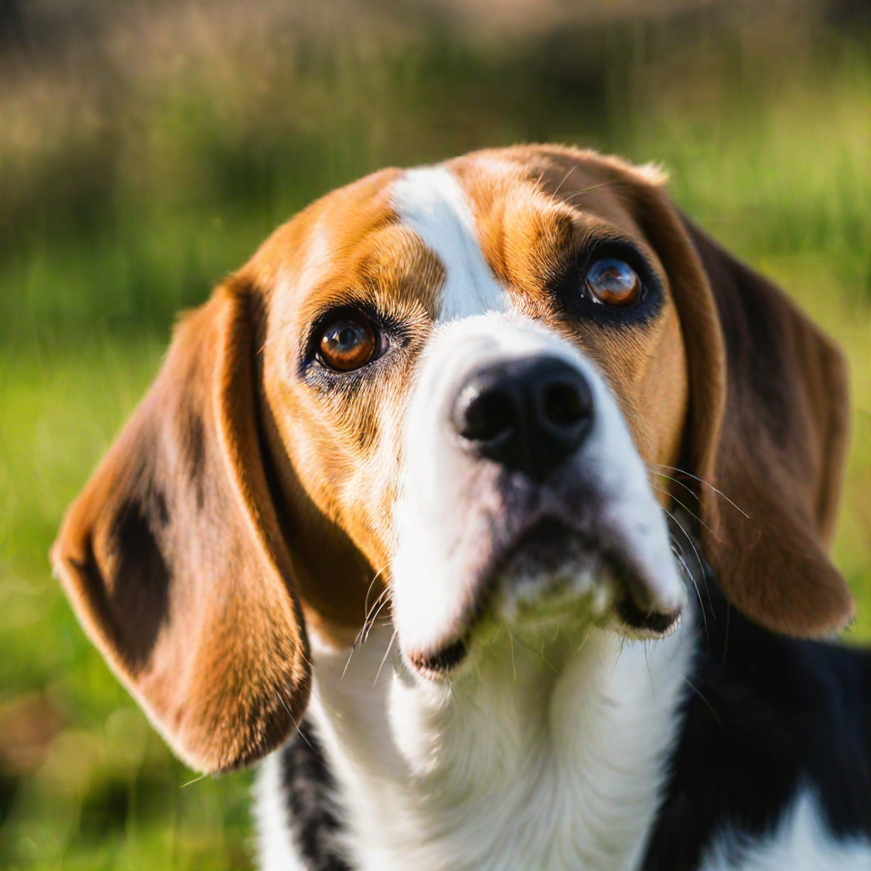
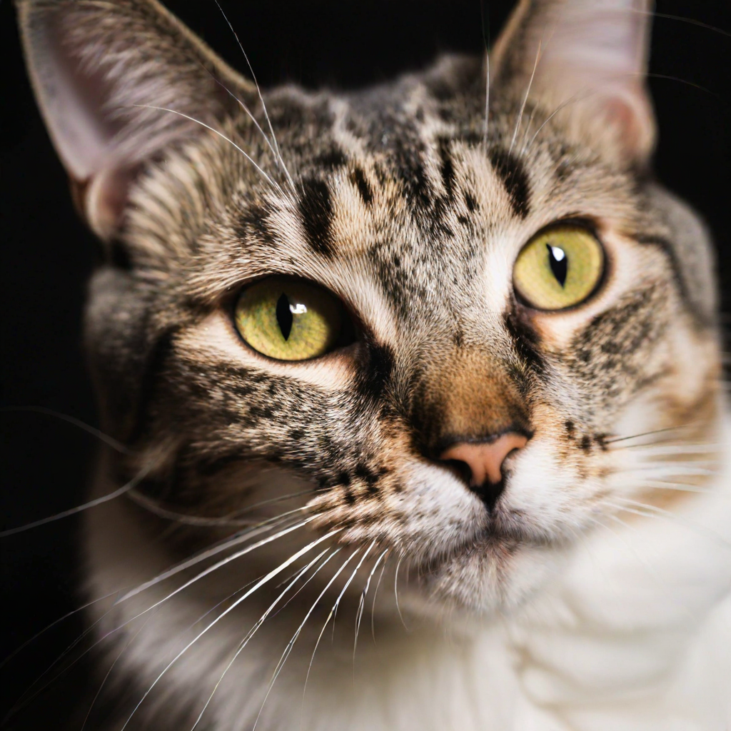
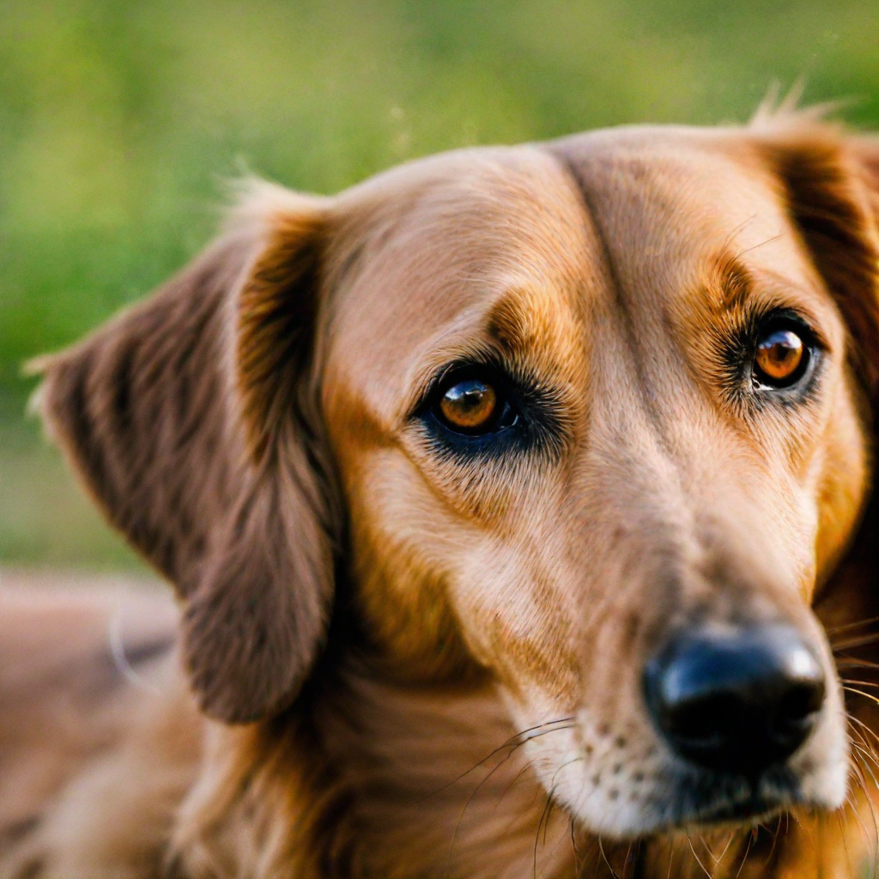
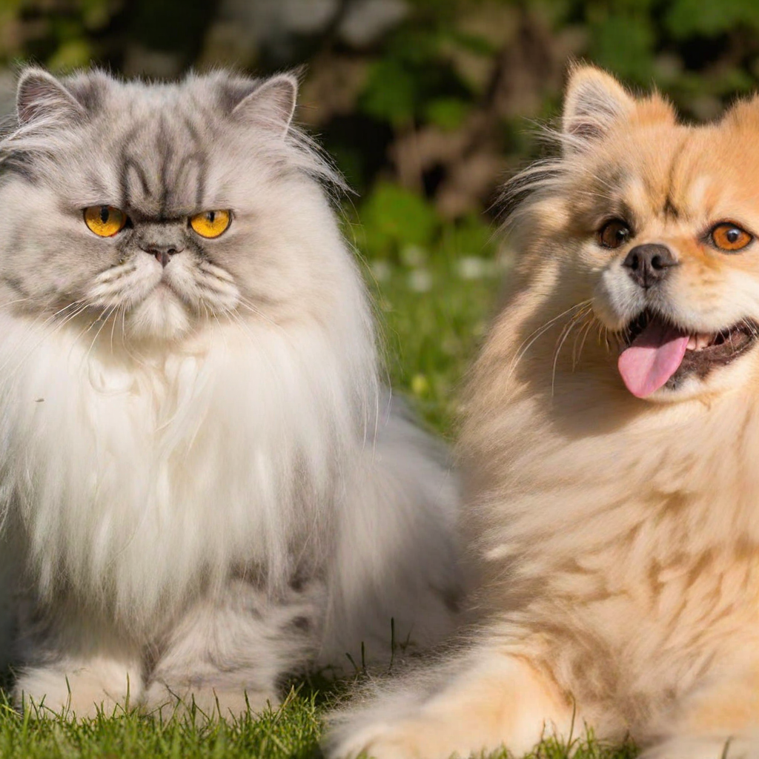
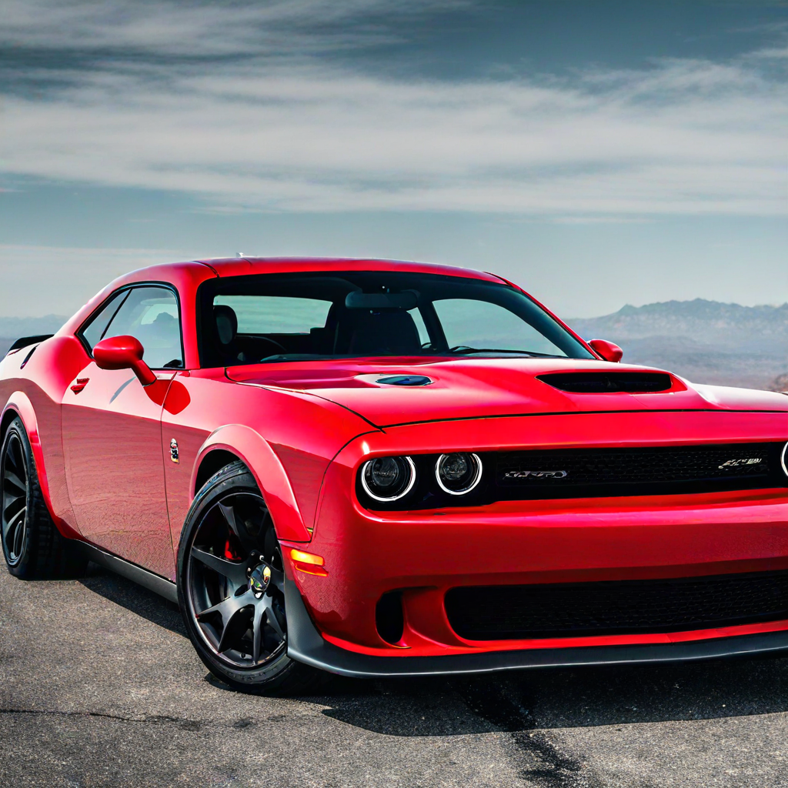
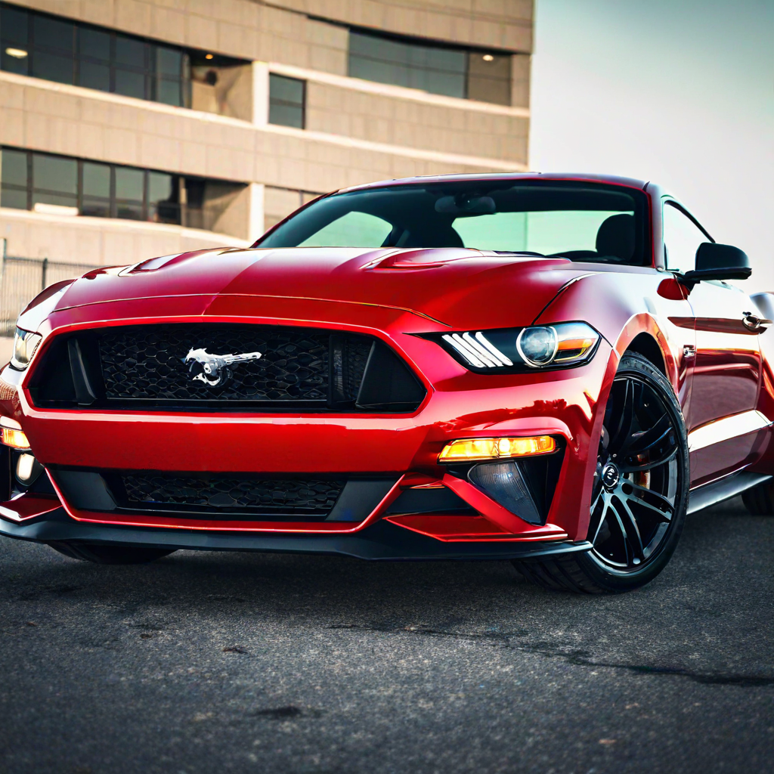
observed Outputs after Implementation:
Improved Distribution Matching Distillation for Fast Image Synthesis (DMD2)
A Beagle dog
A Cat
A Golden Retriever Dog
A Persian Cat and a dog
Dodge Challenger hellcat
Ford Mustang Shelby gt500

Slide 6
Results and Discussions
1. Improved Distribution Matching Distillation for Fast Image Synthesis (DMD2) for SDXL:
Image Synthesis: Improved image quality with fewer time steps compared to the traditional distillation approach.
Efficiency: Achieved a balance between model size and performance, with reduced computational requirements.
Stability and Quality: Introduces a two time-scale update rule and integrates a GAN loss to enhance training stability and image quality.
Multi-step Sampling: Proposes a new training procedure that supports multi-step generators, improving performance over one-step methods.
Benchmark Results: Achieves state-of-the-art results in one-step image generation, surpassing the original teacher models in quality and efficiency.
2. Insights Gained:
Effective Distillation: Improved distribution matching techniques significantly enhanced model efficiency and image quality.
Optimization: Distillation strategies are effective in reducing computational costs while maintaining or improving model performance.

Slide 7
References
Diffusion Models and techniques referred:
https://tianweiy.github.io/dmd2/
https://tianweiy.github.io/dmd/
https://huggingface.co/tianweiy/DMD2
https://github.com/baofff/U-ViT
https://github.com/google-research/google-research/tree/master/diffusion_distillation
2. Research Articles referred:
https://arxiv.org/pdf/2202.00512 - Progressive Distillation for Fast Sampling of Diffusion Models.
https://arxiv.org/pdf/2209.12152 - All are Worth Words: A ViT Backbone for Diffusion Models
https://arxiv.org/pdf/2311.18828 - One-step Diffusion with Distribution Matching Distillation
https://arxiv.org/pdf/2405.14867 - Improved Distribution Matching Distillation for Fast Image Synthesis

